Slide 1
Voir Dire: Time to Listen
Claire Lettow, Managing Attorney (Great Falls)

Slide 2
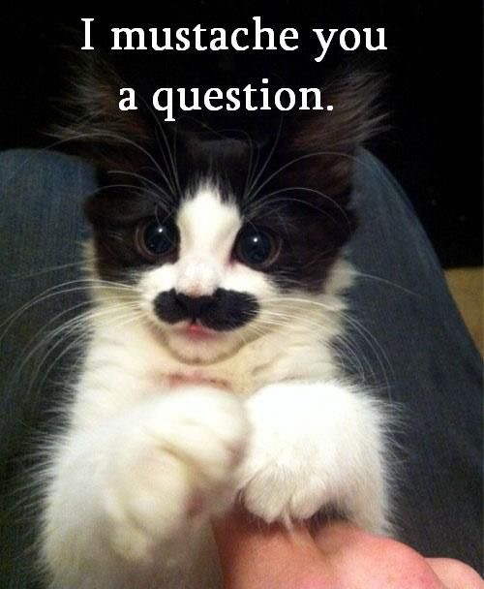
Agenda
What is the case?
What do I want to know?
Who are these people?
How do I get rid of someone?

Slide 3
Question:
If you could ask anyone, dead or alive, one question what would you ask?

Slide 4
What’s your case?
The charge:
Against a person
Property/theft
Status Offense
Drugs (residue, constructive)
DUI
Sex Offense
The issues:
Police
Credibility (kids, liars)
Nervous defendants
Perception
Race

Slide 5
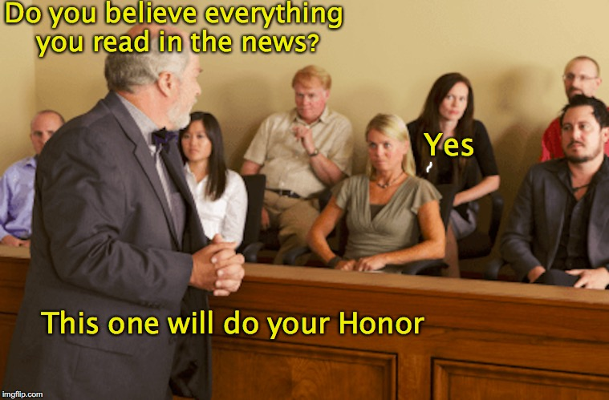
What do I want to know?
Depends on the charge
Depends on the issues
Depends on current events

Slide 6
Charge: against a person
PFMA:
Anyone ever been in an argument with their spouse?
Get pretty heated?
What was that like?
Anyone ever been hit by their significant other?
Self Defense:
When you think of self-defense, what comes to mind?
Been in a bar fight? Tell me about it.
AOPO:
-Raise your hand if you trust the police more than the general public. Why?
Raise your hand if you believe that police have a tough job. Why?
Raise your hand if you think people criticize the police too much. Why?

Slide 7
Charge: Status Offenses
Raise your hand if you trust the government. Why?
What are some reasons why someone wouldn’t trust the government?
Raise your hand if you think cops cut corners sometimes. Why do you think they cut corners?
Do you think you should have to help cops do their jobs? Discuss
What would you expect a thorough investigation to look like?

Slide 8
Charge: Drugs
Addiction: is it a disease or a choice?
Anyone have really strong feelings about meth? Tell me about it.
Anyone know someone who was addicted to meth? What can you tell me?
(Was that experience too personal to be fair today since we’re talking about meth?)
*Residue: Aspirin bottle example
*Constructive Possession: PO Box key example

Slide 9
Charge: DUI
Anyone drink? What do you drink? When do ya drink? When you drink, how much?
Anyone been charged with a DUI? What happened?
(Proceed with caution re: jurors w/ DUI convictions)
Is it possible to drive safely after a few drinks? Why do you think that?
Raise your hand if you think alcohol DUIs and drug DUIs are different? Why?
Does it depend on the drug?

Slide 10
Charge: Sex offenses
#metoo movement – raise your hand if you support it. Why?
Anyone think it’s a liberal movement? How does that make you feel?
Do you think it’s a phony Hollywood movement?
Raise your hand if you think sexual abuse is too serious to lie about. Why?
Anyone think of a reason why someone would accuse a person of sexual abuse if it didn’t happen?

Slide 11
Issues: police
Ask about current events!
“Anyone pay attention to the Kyle Rittenhouse case?
How did you feel about that kid getting acquitted?”
Is police brutality something we don’t need to be concerned about in our community? Why or why not?
Raise your hand if you trust the police more than the general public. Why?
Raise your hand if you believe that police have a tough job. Why?
Raise your hand if you think people criticize the police too much. Why?
Should a police officer wear the thin blue line flag on their uniform?

Slide 12
Issues: Credibility
Have you ever talked yourself out of speeding ticket? Do you remember what you said?
Can you tell me about the most serious time that you or someone you know told a lie to get out of trouble?
When it comes to children telling stories, what makes them reliable?
If a child makes a very serious allegation are you more likely to believe the child? Why?
How are you going to know if a child is telling the truth?

Slide 13
Issues: Nervous Defendants
Anyone been pulled over when you didn’t think you did anything wrong? What was that like?
Did the officer treat you fairly?
Were you nervous?
Why were you nervous if you didn’t do anything wrong?

Slide 14
Issues: Perception
The Ambiguous Color example

Slide 15
Issues: Race
Are people sometimes treated differently because of their race? Why do you think that is?
Raise your hand if you believe Native American people are more likely to commit a crime. Why?
Can you describe a significant interaction you’ve had with a member of another race?
Now I’d like to see if anyone can identify a Native American person whom you admire?

Slide 16
Who are these people?
Prepare:
Stickies
Juror research (facebook stalking)
Questionnaires
Thanks, Jordan! ☺

Slide 17
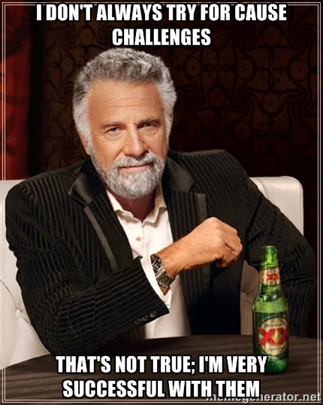
How do I get rid of someone?

Slide 18
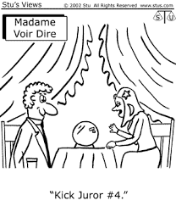
For Cause
Closely held personal belief?
No one can change your mind about it?
Because of your experience, you’d expect me to convince you of my client’s innocence?
And would you agree that due to those feelings/experiences you couldn’t accept as fact that my client is presumed innocent?
You’ve said that you’ll do your best to be fair and impartial, but you’re not sure that your feelings could be set aside?

Slide 19
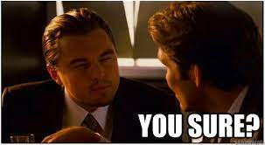
Rehabilitating the Juror
Beware of the leading questions State v. Johnson

Slide 20
Batson
When:
Prosecutor is trying to use a peremptory on a minority juror &
You don’t want that person off the jury
How: Write it on the form and/or make a speaking objection
And then? Pros has to give a race-neutral reason

Slide 21
Final Thoughts

Slide 22
Let’s Practice

